Slide 1
EDA And Prediction Laptop Prices

Slide 2
Introducton
Laptops Dataset contains laptop specifications and it’s prices, In our project we will dive into the Laptops dataset, do analysis, get insights and finally we will create a model to Predict Laptop Prices.
If any user wants to buy a laptop then our application should be compatible to provide a tentative price of laptop according to the user configurations.

Slide 3
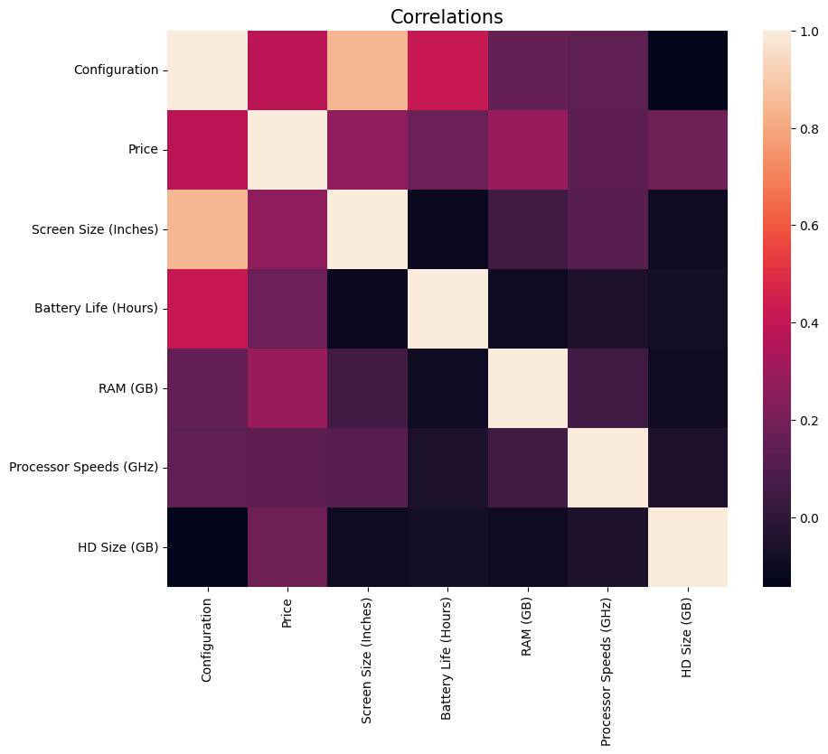
Exploratory Analaysis
Correlation between Numerical Features

Slide 4
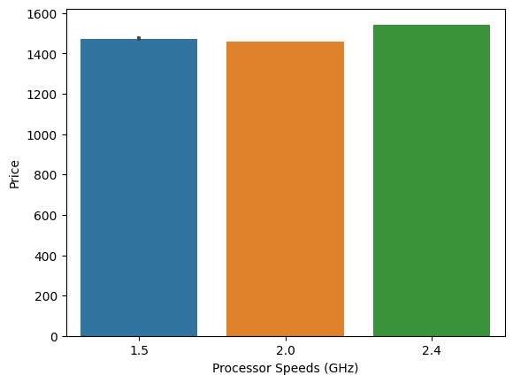
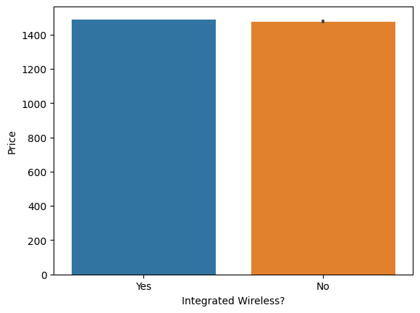
Exploratory Analaysis
Bar plot between Price of laptop and Processor speed
Bar plot between Price of laptop and Integrated Wireless?

Slide 5
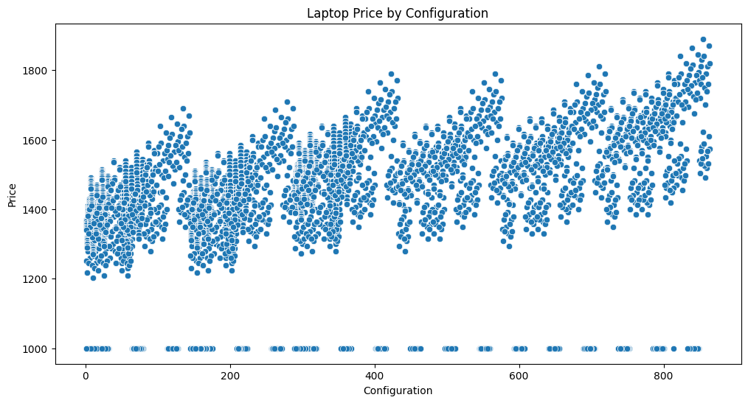
Exploratory Analaysis
Scatter plot between Price of laptop and configuration?

Slide 6
Research Questions
Is there a Notable difference in the Laptops Price across Processor speed category?
Is there a Notable difference in the Laptops Price across Integrated Wireless category?
Anova Analysis questions

Slide 7
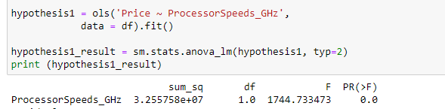
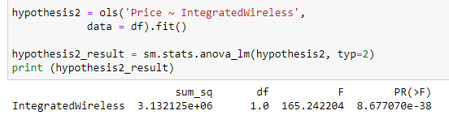
Anova Analysis questions
1-
2-
H0 = The mean Laptop Price is equal for Processor Speeds Category.
H1 = At least one of the Processor Speeds category has a mean price that is not the same as the other Processor Speeds Category.
The p-value of the condition variable is < 0.05,
Which implies that Processor Speeds gives impact on the Laptop Price.
So the H0 is rejected.
H0 = The mean Laptop Price is equal for Integrated Wireless Category.
H1 = At least one of the Integrated Wireless variable has a mean price that is not the same as the other Integrated Wireless variable Category.
The p-value of the condition variable is < 0.05,
Which implies that Integrated Wireless gives impact on the Laptop Price.
So the H0 is rejected.

Slide 8
Research Questions
Can we predict the Laptop price with the given Features using Linear Regression Model ?
Can we predict the Laptop price with the given Features using Logistic Regression Model ?
Regression questions

Slide 9
Data Preprocessing
we Encoded the categorical Variable using One Hot Encoder as machine learning model accepts only numeric values
Normalization for the numerical Data using MinMaxScaler that normalize numeric values to be ranging from 0 to 1.
splitting the data to train and test with percentage 80/20

Slide 10
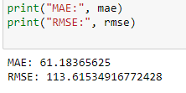
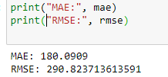
Model
We fitted a linear regression and Logistic regression models using our train data.
Conclusion
Linear regression Model do better than Logistic regression, however the difference in results is not big .
Remembering our regression question we can say now we were able to answer those question, we could predict the Laptop Prices using Linear and logistic Regression, after doing the analysis and getting the needed insights we used Exploratory analysis and Anova analysis to understand more about our dataset then finally the project run successfully by running our models .
Linear regression result:
Logistic regression result:

Slide 11
Thanks

